Slide 1
LC200 New Features
Lumens' mission
is to "fulfill the wishes", "solve the pain" of customers, and become your most reliable partner.

Slide 2
1. Support NAS

Slide 3
Notes:
LC200

Slide 4
1. Origin
Built-in 1 TB storage is not enough for LC200.
Extracting recording files is arduous and tedious, especially when you have multiple LC200 located at discrete places.

Slide 5
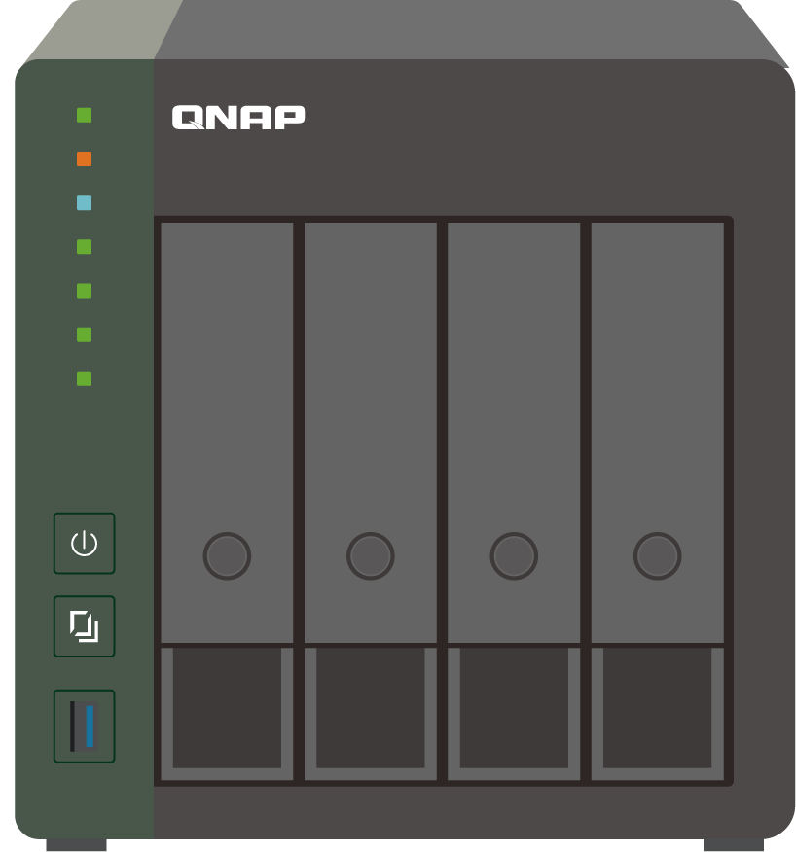
2. What is NAS?
NAS (Network Attached Storage), is a data storage server connected to a network. Devices connecting to the same network can upload and back up files to this NAS storage.
A NAS can consist of multiple drives. It is expandable, providing a massive space for any amount of data storage.
NAS

Slide 6
3. Why NAS?
Enormous storage space: NAS provide massive spaces and it’s easy to expand
Central management: Even multiple LC200 at discrete places can automatically upload recordings into one single NAS storage via the Internet.

Slide 7
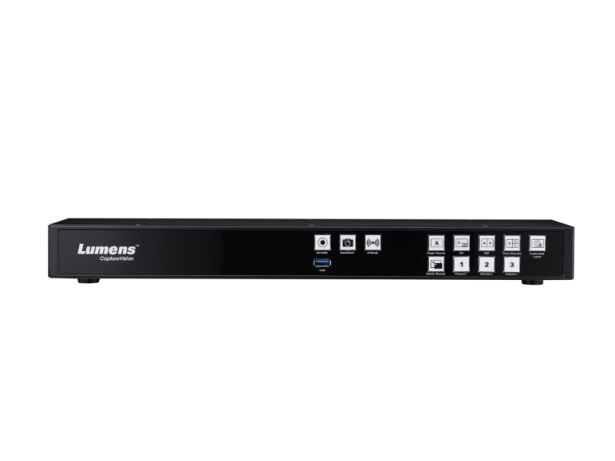
4. New version of LC200
The latest version of LC200 adds new protocols that are commonly used for NAS in addition to FTP/SFTP protocol
CIFS/SMB
NFS
Multiple LC200s can mount the same NAS as their network storage through NFS or CIFS/SMB protocol.
LC200 can set up a daily or periodic backup schedule to the NAS.
FTP
NAS
SFTP
CIFS/SMB
Media Processor
NFS

Slide 8
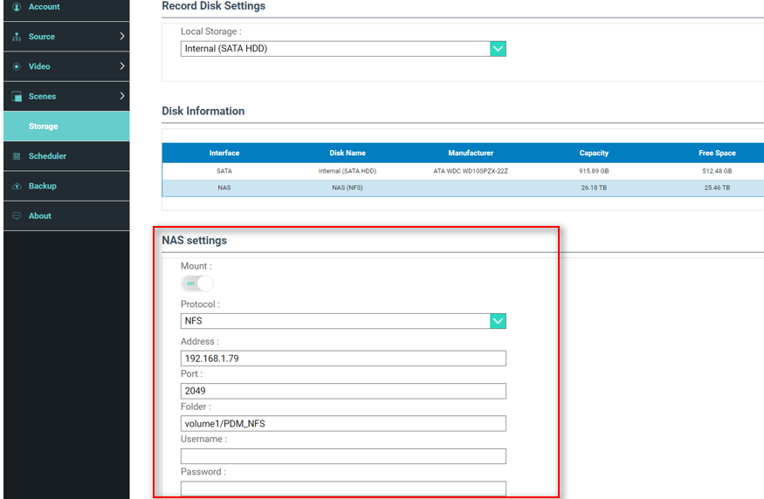
5. How to mount a NAS server?
Log in LC200 web-based portal
Go to Storage, NAS settings
Fill out the NAS information, turn on "mount," and then hit "apply."
If mounting succeeds, you'll see your NAS listed in "Disk Information."

Slide 9
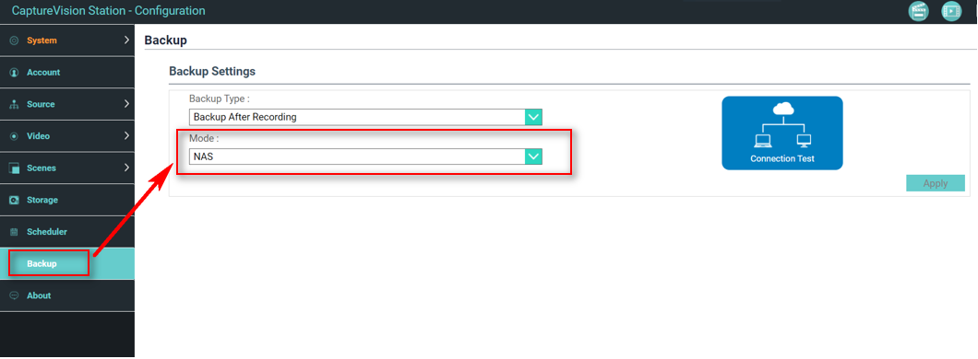
5. How to automatically back up recordings to a NAS server?
Log in LC200 web-based portal
Go to Backup, Backup settings
Go to "Mode:" drop-down menu, select "NAS"
Click "Connection Test"
If it connects, you will see "Connection test succeeded."
Click "Apply"

Slide 10
5. Battle Card
 | Lumens LC200 | Extron SMP-351 | Epiphan Pearl Mini
FTP | Yes | Yes | Yes
SFTP | Yes | Yes | Yes
NAS (CIFS/SMB) | Yes | Yes | Yes
NAS (NFS) | Yes | No | No

Slide 11
2. Front Panel Lock

Slide 12
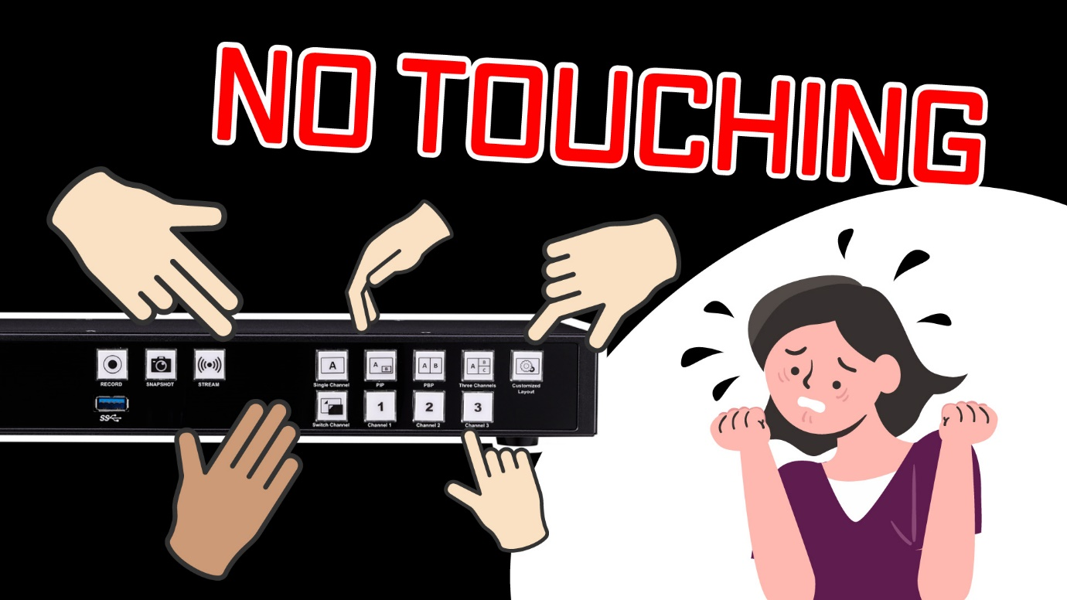
1. Origin
When an LC200 is placed in an open space, non-staff may accidentally touch function keys on the front panel.
For example, students unintentionally stop the ongoing recording.
To avoid the above situation, the administrator can lock down the front panel operation.

Slide 13
2. New version of LC200
The latest version of LC200 adds a new function to lock down the front panel.
Only an authorized administrator account can lock/unlock the front panel operation.

Slide 14
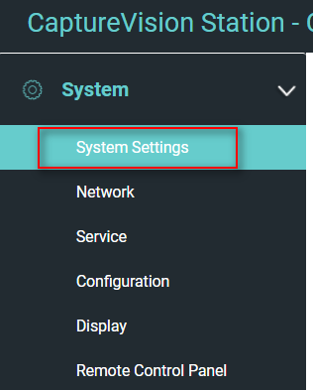
3. How to set up Frone Panel Lock?
Log in LC200 web-based portal by the administrator account
Go to "System" -> "System settings" -> "Front panel lock“
Select "Front panel lock," and then click "Apply.“
Note: The setting does not affect onboard GUI, webpage control, or control commands

Slide 15
4. Battle Card
 | Lumens LC200 | Extron SMP-351 | Epiphan Pearl Mini
Front Panel Lock | Yes | Yes | No

Slide 16
3. Intermission

Slide 17
1. Origin
During the live streaming event, hosts sometimes take a break time. The event host would need to mute cameras and audio without disconnecting streaming at this intermission.

Slide 18
1.1 Origin
In some Pro AV applications, a courtroom, for example, when some sensitive or privacy moment occurs, the proceedings would require quickly muting cameras and audio without stopping live streaming.

Slide 19
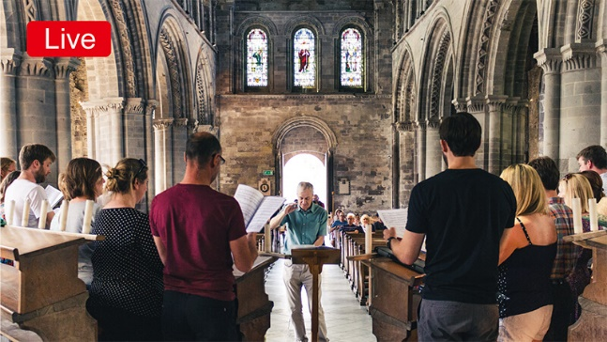
2. The New Version of LC200
Just one click, you can switch to the intermission scene instantly or back to live streaming.
The event host can design its own "break time scene."
Intermission
Live

Slide 20
3. How to put ”Intermission” in action?
Onboard GUI and web-based director are added two buttons, Intermission and Live
Function explained
Button | Video | Audio
Intermission | PGM shows ”Intermission Scene” | Mute PGM Audio
Live | PGM back to live | Unmute PGM Audio

Slide 21
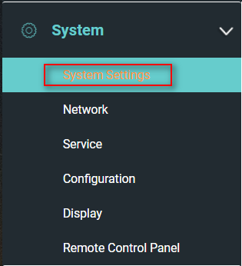
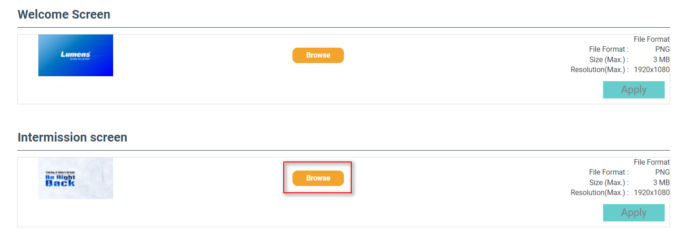
4. How to change “Intermission Scene”?
Design your own Intermission Scene (1920 x 1080 .PNG required)
Log in LC200 web-based portal -> Go to "System" -> "System settings" -> "Intermission Screen“
Click "Browse" and choose your PNG image
Click "Apply"

Slide 22
5. Battle Card
 | Lumens LC200 | Extron SMP-351 | Epiphan Pearl Mini
Intermission Function | Yes | No | No

Slide 23
4. Marco

Slide 24
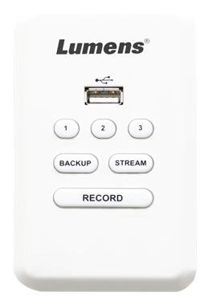
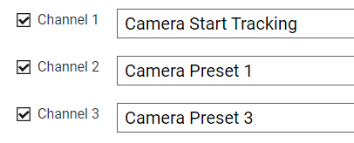
1. What is a Macro?
Macro is remote control panel’s function key that allows users to quickly switch to a specific scene and designated camera views for each channel.
Macro
Scene
Camera View

Slide 25
2. How to execute Macro?
1. LC-RC01 Remote control panel
2. Third party controller
Command
Macro
You can set up to 3 macros

Slide 26
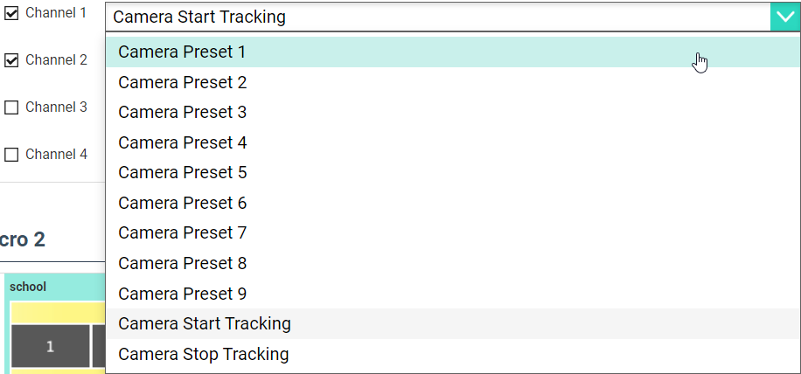
3. How to Configure a Macro?
1. Select a scene
2. Select channels
3. Select camera actions



Slide 27
4. Battle Card
Only Lumens media processors have the “Macro” function
Only Lumens use “Macro” to automate PTZ cameras and auto-tracking cameras
 | Lumens LC200 | Extron SMP-351 | Epiphan Pearl Mini
Optional Remote Control Panel | Yes | Yes | No
Macro function | Yes | No | No
Macro to control PTZ cameras | Yes | No | No

Slide 28
5. Pause recording

Slide 29
1. Origin
"Pause" is an essential function when you need to take a break or conduct private conversation during the recording.
For example, during courtroom proceedings, police statement records, or government meetings.

Slide 30
3. How to pause during recording?
New Pause / Resume buttons on GUI Director
Function
Icon | Function
 | Start Recording
 | Stop Recording
 | Pause Recording
 | Resume Recording

Slide 31
5. Battle Card
 | Lumens LC200 | Extron SMP-351 | Epiphan Pearl Mini
Pause / Resume Recording | Yes | Yes | TBD

Slide 32
6. Panopto multi streams

Slide 33
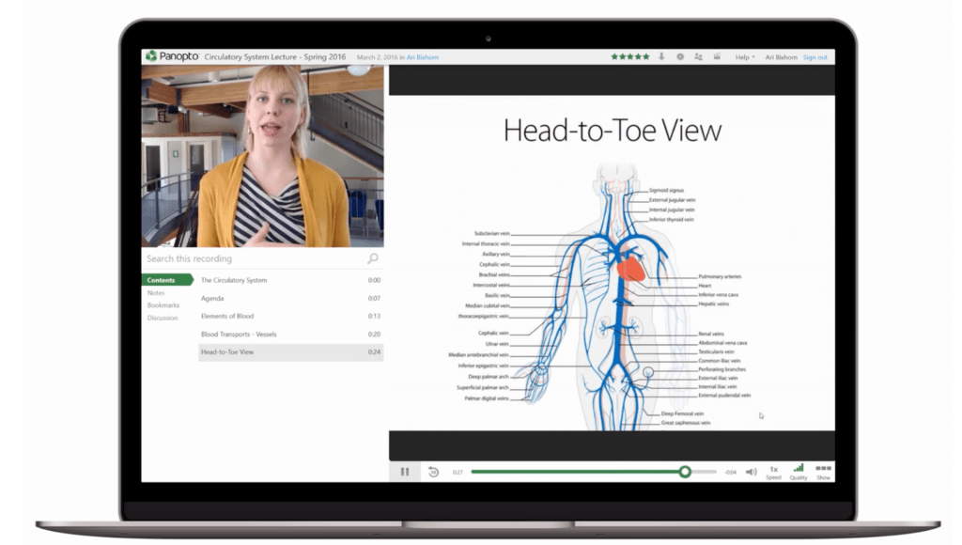
1. What is Panopto?
Panopto is a cloud-based video management platform for education or corporate training. Users can upload recording files to the Panopto server for archive and content management.
Panopto provides real-time Webcast streaming.

Slide 34
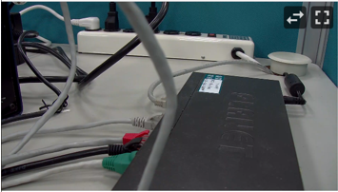
2. Origin
During Panopto Webcasting, viewers can watch one major stream and one sub-stream. One sub-stream can be chosen from three sources.
Viewers can choose and focus on what they want to watch.
Sub-stream
Major Stream
Stream 1
Stream 2
Stream 3

Slide 35
3. The new version of LC200
The integration between Panopto and Lumens allows LC200 to be scheduled, webcasting, and automatically upload files after recording.
The latest LC200 can simultaneously push up to 4 streams from five sources (PGM, Channel 1, Channel 2, Channel 3, Channel 4) according to users’ choice.
PGM
Channel 1
Channel 2
Major Stream
Stream 1
Stream 2
WebCast
Channel 3
Stream 3
Channel 4

Slide 36
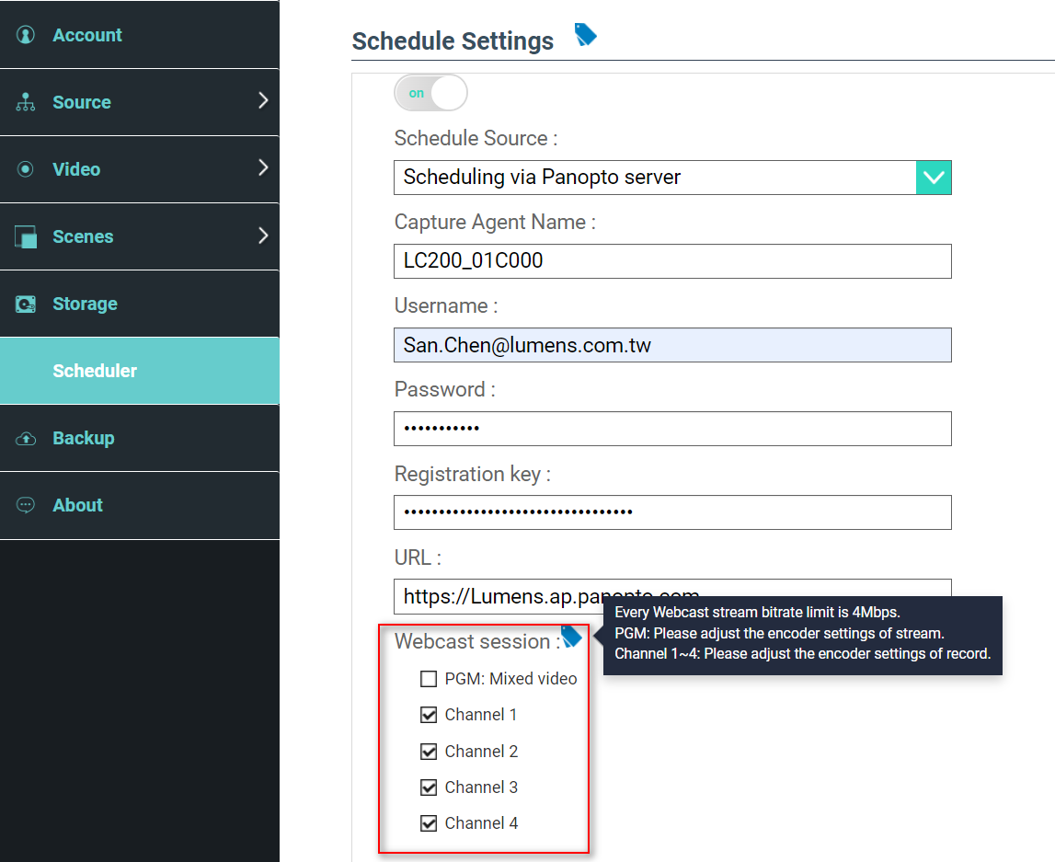
5. How to Set up?
Log in LC200 web-based portal
Go to "Scheduler" -> "Schedule Settings" -> "Webcast session"
You can select four out of five options that you want to stream to Webcast session.
For Panopto setup, please watch this video: https://www.youtube.com/watch?v=gGhw1XIGe7g

Slide 37
5. Battle Card
 | Lumens LC200 | Extron SMP-351 | Epiphan Pearl Mini
Panopto Webcast support | Yes | Yes | Yes
Multi-stream for Panopto Webcast | 4 | 2 | 2
Multi-stream recording | 5 | 1 | 1

Slide 38
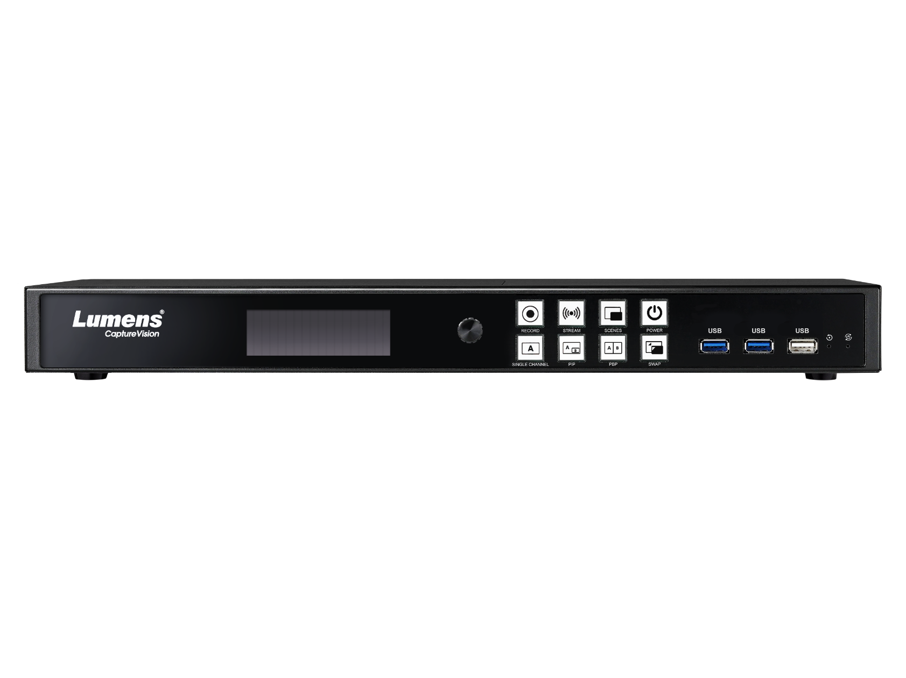
6. Models with new features
LC200
Multi-stream up to 4
LC100
Multi-stream up to 3

Slide 39
Thank You!

